Slide 1
SEN152 – Topic 3: Software development methods, tools, and modelling techniques
3.1 Software development methods and tools
3.2 Software development modelling techniques
3.3 Software modelling examples
3.4 Software modelling exercises

Slide 2
Module Outcomes
Demonstrate insight in the history of software development.
Demonstrate an understanding of different options for software development life cycles related to software design and development, and key terms, facts, principles and rules of software development.
Apply methods, tools and modelling techniques commonly employed during the various phases of software development.
Demonstrate an understanding of the importance of software maintenance and documentation.
Identify modern software development and management platforms, tools, and services, and outline the nature of the support provided.
Demonstrate an understanding of the notion of quality in software and how a Quality Management System can provide the required organisational framework.

Slide 3
3.1 Software development methods and tools
Software development teams use a variety of methods or techniques to successfully complete software development projects.
There are numerous techniques and tools available to support developers throughout the various phases of software development.
For example, team meetings occur throughout a software development project. The team meeting would be the technique, and the tools could be Microsoft Teams to create a space for the online meeting, Microsoft Word to capture the meeting minutes and Microsoft Outlook to distribute the communication content.

Slide 4
3.1 Software development methods and tools
During the analysis phase, analysts use tools to draw many types of diagrams to model the system requirements.
During the coding or implementation phase, developers use Integrated Development Environments (IDEs) that provide code editing, debugging, etc.
Other tools are debugging tools, version control system tools, build automation tools and testing tools.

Slide 5

3.1 Software development methods and tools
Using software tools throughout the SDLC is vital for ensuring the successful planning, development, deployment, and maintenance of software systems.

Slide 6
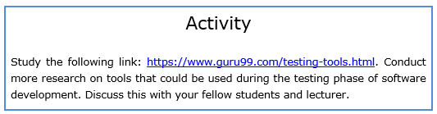
3.1 Software development methods and tools
https://www.guru99.com/testing-tools.html.

Slide 7
3.2 Software development modelling techniques
3.2.1 Modelling techniques overview
In the IT industry, systems analysts create both logical and physical models, often in the form of diagrams before moving into the development phase.
These diagrams serve as blueprints that guide programmers in building the system based on the analysts' detailed specifications.
Different types of diagrams are used to highlight various aspects of the system.

Slide 8
3.2 Software development modelling techniques
3.2.1 Modelling techniques overview
For process modelling, analysts draw flow charts and data flow diagrams (DFDs).
The context diagram is the highest-level DFD, offering a broad overview of the entire system and its interactions with external entities. From this, lower-level DFDs are developed to explore each process in greater detail.
A DFD is an essential tool for modelling business and system processes.

Slide 9
3.2 Software development modelling techniques
3.2.1 Modelling techniques overview
Conceptual data modelling focuses on representing an organisation’s data, and the aim is to highlight the rules related to the meaning and interrelationships among an organisation’s data.
Main aim of conceptual data modelling is to create an Entity-Relationship Diagram (E-R diagram or ERD).

Slide 10
3.2 Software development modelling techniques
3.2.1 Modelling techniques overview
Unified Modelling Language (UML) is a collection of visual notations used to describe and design software systems through diagrams.
While it is particularly suited for object-oriented software, several elements of UML can be applied to other software types as well.
Various UML notations are tailored for specific diagram types, each serving a unique role in modelling.
Analysts do not have the time (or project money) to draw every single diagram.

Slide 11
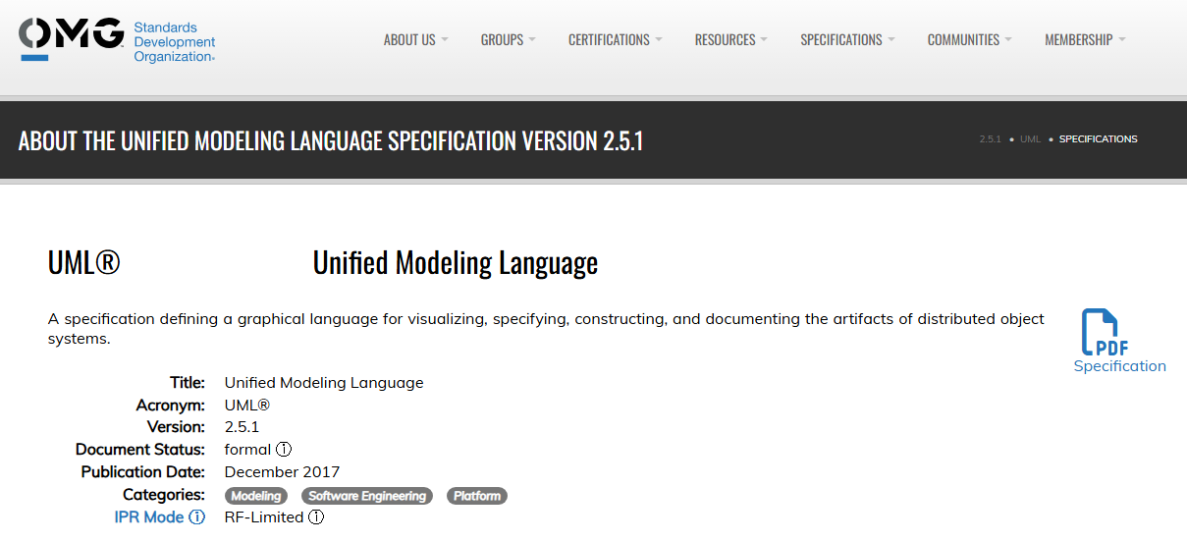
3.2 Software development modelling techniques
UML is currently at version 2.5.1. (https://www.omg.org/spec/UML)

Slide 12
3.2 Software development modelling techniques
UML 2.0 Diagrams: (NOTE: Only these 3 diagrams will be assessed in this module)
Use case diagram: Depicts the interaction between the system and external systems and users. It graphically describes who will use the system and how the user expects to interact with it.
Class diagram: Represents the system’s object structure, showing object classes and the relationships between them.
Activity diagram: Shows the sequential flow of activities in a use-case or business process. It can also model internal logic within the system.

Slide 13
3.2 Software development modelling techniques
UML 2.0 Diagrams:
Object diagram: Like a class diagram, but models actual object instances with current attribute values, providing a snapshot at a specific moment.
State machine diagram: Illustrates how events cause changes in an object’s state over its lifetime, showing various states and transitions.
Composite structure diagram: Breaks down the internal structure of a class, component, or use case.

Slide 14
3.2 Software development modelling techniques
UML 2.0 Diagrams:
Sequence diagram: Shows how objects interact through message exchanges during a use case or operation, including the sequence of these messages.
Communication diagram: Formerly called a collaboration diagram in UML 1.X, it focuses on the structure of object interactions via messages, emphasizing organization rather than timing.
Interaction overview diagram: Combines sequence and activity diagram features to show object interactions within each activity of a use case.

Slide 15
3.2 Software development modelling techniques
UML 2.0 Diagrams:
Timing diagram: Focuses on timing constraints and state changes of objects, particularly useful in embedded software design.
Component diagram: Illustrates the organization of programming code into components and how these components interact.
Deployment diagram: Displays how software components are configured on the physical system hardware nodes.
Package diagram: Shows how UML elements (like classes) are grouped into packages and how those packages depend on each other.

Slide 16
3.2 Software development modelling techniques
3.2.2 Use case modelling
Use cases provide a structured and formalised approach to specifying functional requirements, detailing the expected behaviour of a system during user interactions.
Use case modelling, a key aspect of object-oriented modelling, has also been adopted in traditional development environments due to its effectiveness in capturing system requirements.
It represents the functions a system should perform from the perspectives of users and stakeholders, making it a widely accepted method for defining, documenting, and understanding functional requirements.

Slide 17
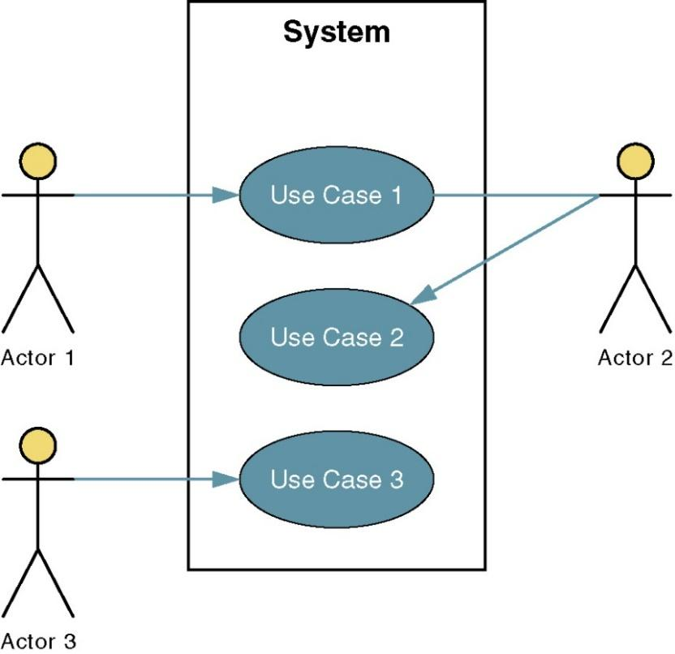
3.2 Software development modelling techniques
3.2.2 Use case modelling

Slide 18
3.2 Software development modelling techniques
3.2.2 Use case modelling
Before developing a use case model, it is important to first identify the actors, such as users, external systems, or time-based triggers, as well as the potential use case events and the relationships among them.
Each use case event should be action-oriented and begin with a verb (e.g., 'Generate monthly student attendance report'). A complete use case diagram provides a visual representation of all possible interactions within the system.

Slide 19
3.2 Software development modelling techniques
3.2.2 Use case modelling
The following are use case modelling steps by Whitten & Bentley (2007):
Identify the actors.
Identify the use cases.
Construct use-case model diagram.
Document the requirements use-case narratives.

Slide 20
3.2 Software development modelling techniques
3.2.2 Use case modelling
Name: A concise title for the use case, typically beginning with a verb (e.g., "Schedule weekly wellness check"). It briefly states the user's objective that the use case will describe.
Actor(s): The individual(s), system(s), or device(s) interacting with the software—these may be human, nonhuman, or automated entities (e.g., "Medical staff").
Flow of Events: A sequential description of the interactions between the actor and the system. This outlines the typical steps taken to achieve the use case goal, also known as the basic course of action or success scenario.

Slide 21

3.2 Software development modelling techniques
3.2.2 Use case modelling
A primary business actor is the stakeholder who primarily benefits from the execution of a use case. For example, an employee receiving a paycheck is considered a primary business actor.
A primary system actor is the stakeholder who directly interacts with the system to initiate or trigger a business or system event, such as a bank teller entering deposit information.

Slide 22
3.2 Software development modelling techniques
3.2.2 Use case modelling
An external server actor is a stakeholder that responds to a request from the use case, like a credit bureau authorizing a credit card charge.
An external receiver actor is a stakeholder who is not the primary actor but still receives something of value from the use case, such as a warehouse receiving a packing slip.

Slide 23
3.2 Software development modelling techniques
3.2.2 Use case modelling
Use cases should be named using a verb phrase that clearly defines the actor's objective (e.g. ‘Place Subscription Order’). To identify use cases, ask these questions (Whitten & Bentley, 2007):
What are the primary responsibilities of the actor?
What data does the actor require from the system?
What data does the actor input into the system?
Should the system notify the actor about any updates or events?
Should the actor notify the system about any updates or events?

Slide 24
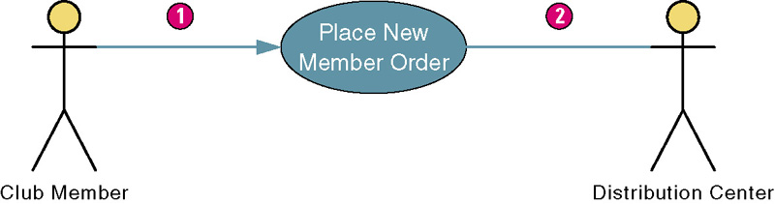
3.2 Software development modelling techniques
3.2.2 Use case modelling
An association is a relationship (interaction) between an actor and a use case and represented as a solid line connecting an actor and a use case. If the association includes an arrowhead pointing to the use case, it signifies that the actor initiated the use case (1).
If there is no arrowhead, it indicates a receiver actor (2). Associations can be either bidirectional or unidirectional, depending on the nature of the interaction between the actor and the use case.

Slide 25
3.2 Software development modelling techniques
3.2.3 Class diagram
A class diagram provides a visual representation of a system's classes and the static relationships among them.
It also illustrates the properties and operations associated with each class.
Properties define the structure of a class, such as its instance variables, while operations specify the behaviour or functionality that the class offers.

Slide 26
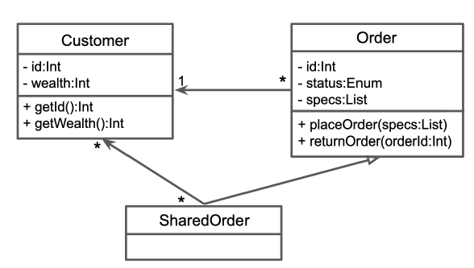
3.2 Software development modelling techniques
3.2.3 Class diagram
There are relationships in the diagram between three classes: Customer, Order, and SharedOrder. An Order has one Customer; but the same Customer can be linked to many Orders. A SharedOrder is a type of Order that can consist of many Customers. The classes have attributes (id) and operations (getId()).

Slide 27
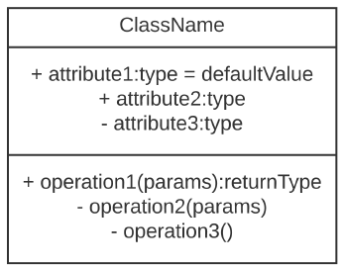
3.2 Software development modelling techniques
3.2.3 Class diagram
Attributes are the properties listed within a class box, while operations correspond to the methods of the class. Visibility indicators are used to denote access levels: '+' signifies a public method, '–' indicates a private method, and '#' represents a protected method.
The notation also includes attribute data types (e.g., int, Token), method parameters and return types, as well as default values assigned to attributes.

Slide 28
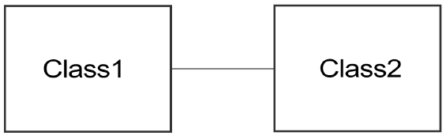
3.2 Software development modelling techniques
3.2.3 Class diagram
An association represents a relationship in which one class holds a reference to one or more objects of another class, typically in the form of a property.

Slide 29
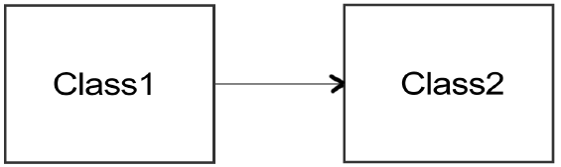
3.2 Software development modelling techniques
3.2.3 Class diagram
The arrow shows that Class1 has a Class2.

Slide 30
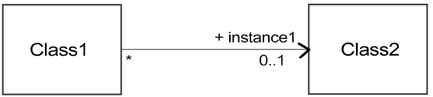
3.2 Software development modelling techniques
3.2.3 Class diagram
Multiplicity defines how many instances of one class can be associated with a single instance of another class.
It is shown at the ends of association lines in UML class diagrams and helps describe the cardinality of the relationship.

Slide 31
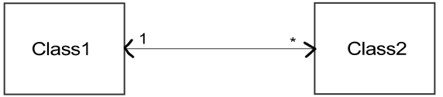
3.2 Software development modelling techniques
3.2.3 Class diagram
Class1 has zero or more instances of Class2. Class2 has exactly one instance of Class1.

Slide 32
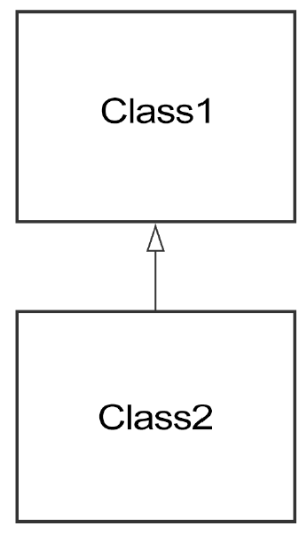
3.2 Software development modelling techniques
3.2.3 Class diagram
Inheritance in a class diagram represents a hierarchical relationship between classes, where one class (the subclass or child class) inherits attributes and operations from another class (the superclass or parent class).
This allows for code reuse and logical organization of shared behaviour.

Slide 33
3.2 Software development modelling techniques
3.2.4 Activity diagram
The purpose of an Activity diagram is to model the dynamic aspects of a system, with a focus on the flow of control from one activity to another.
It is used to describe the logic of business processes or software system processes, helping to visualize how tasks are carried out in sequence or in parallel.

Slide 34
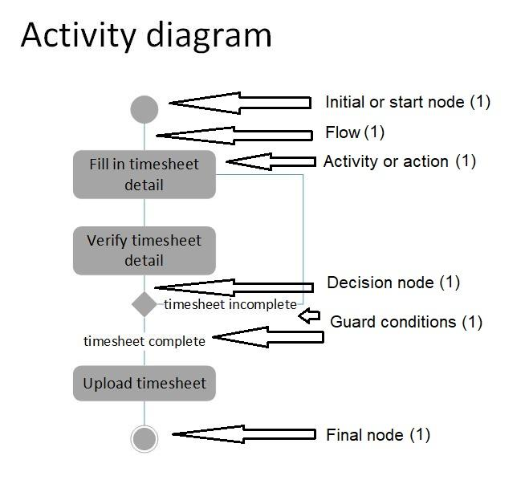
3.2 Software development modelling techniques
3.2.4 Activity diagram
Notation

Slide 35
3.2 Software development modelling techniques
3.2.4 Activity diagram
The following plan before drawing activity diagram for scenario of buying a new house:
Start Node (●)
Search for House (Activity)
Shortlist Houses (Activity)
Visit Houses (Activity)
Decision: Found Suitable House? (Diamond)
Yes → Proceed to Next Step
No → Go back to Search for House

Slide 36
3.2 Software development modelling techniques
3.2.4 Activity diagram
Get Pre-Approval for Mortgage (Activity)
Make an Offer (Activity)
Decision: Offer Accepted? (Diamond)
Yes → Proceed to Next Step
No → Return to Shortlist Houses
Home Inspection (Activity)
Decision: Satisfied with Inspection? (Diamond)
Yes → Proceed
No → Return to Shortlist Houses or Renegotiate

Slide 37
3.2 Software development modelling techniques
3.2.4 Activity diagram
Finalize Mortgage (Activity)
Sign Contract and Close Deal (Activity)
Move In (Activity)
End Node (◎)

Slide 38
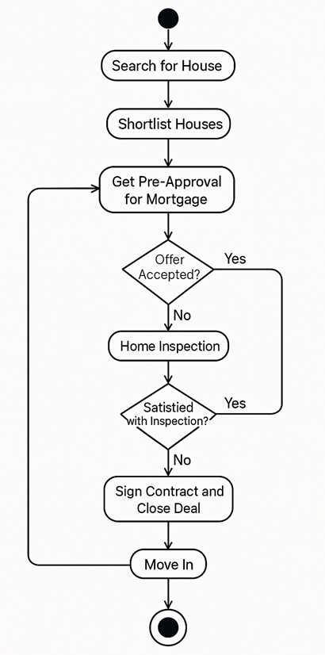
3.2 Software development modelling techniques
3.2.4 Activity diagram

Slide 39
3.3 Software modelling examples
NOTE:
Study the example case studies and diagrams in detail with the guidance of your lecturer.
Study Guide: 3.3

